Slide 1
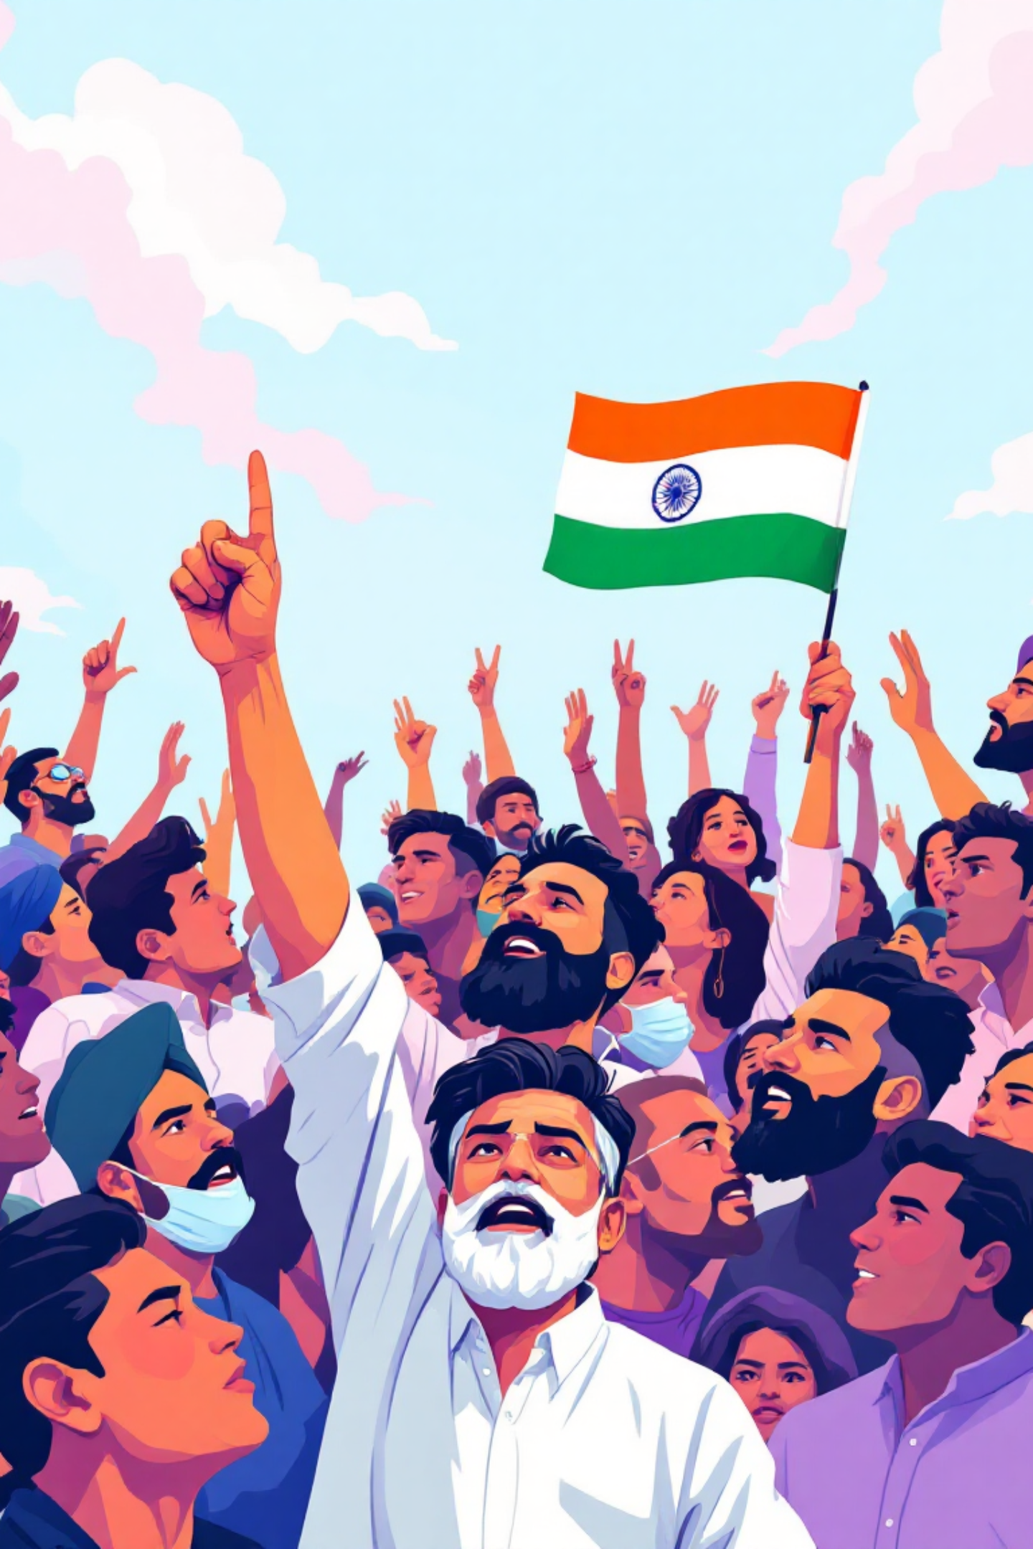
Political Parties in India: Why They Matter and How They Can Evolve
Political parties are fundamental to India's vibrant democracy. They are not merely electoral machines but essential institutions that represent diverse voices, shape public policy, and provide a framework for governance. This presentation delves into their crucial role, functions, challenges, and avenues for reform, aiming to understand how these pivotal entities can strengthen the democratic fabric of the nation.

Slide 2




Why Do We Need Political Parties?
Political parties are the bedrock of parliamentary democracy in India. They perform indispensable functions that ensure the system's smooth operation and responsiveness to its citizens.
Representation & Aggregation
Leadership & Policy-making
Parties act as primary vehicles for political representation, aggregating diverse interests from across India's vast and varied population. They distill complex societal demands into coherent policy platforms.
They are crucial for developing political leadership and providing a structured framework for policy-making. Parties articulate visions for the nation and translate them into actionable government policies.
Citizen Participation
Structure & Accountability
Parties enable citizens to participate meaningfully in governance, offering channels for engagement beyond mere voting. They mobilise public opinion and bring citizen concerns to the legislative agenda.
Without parties, democratic governance would lack essential structure, accountability, and organised debate. They provide the necessary framework for checks and balances, ensuring government responsibility.

Slide 3
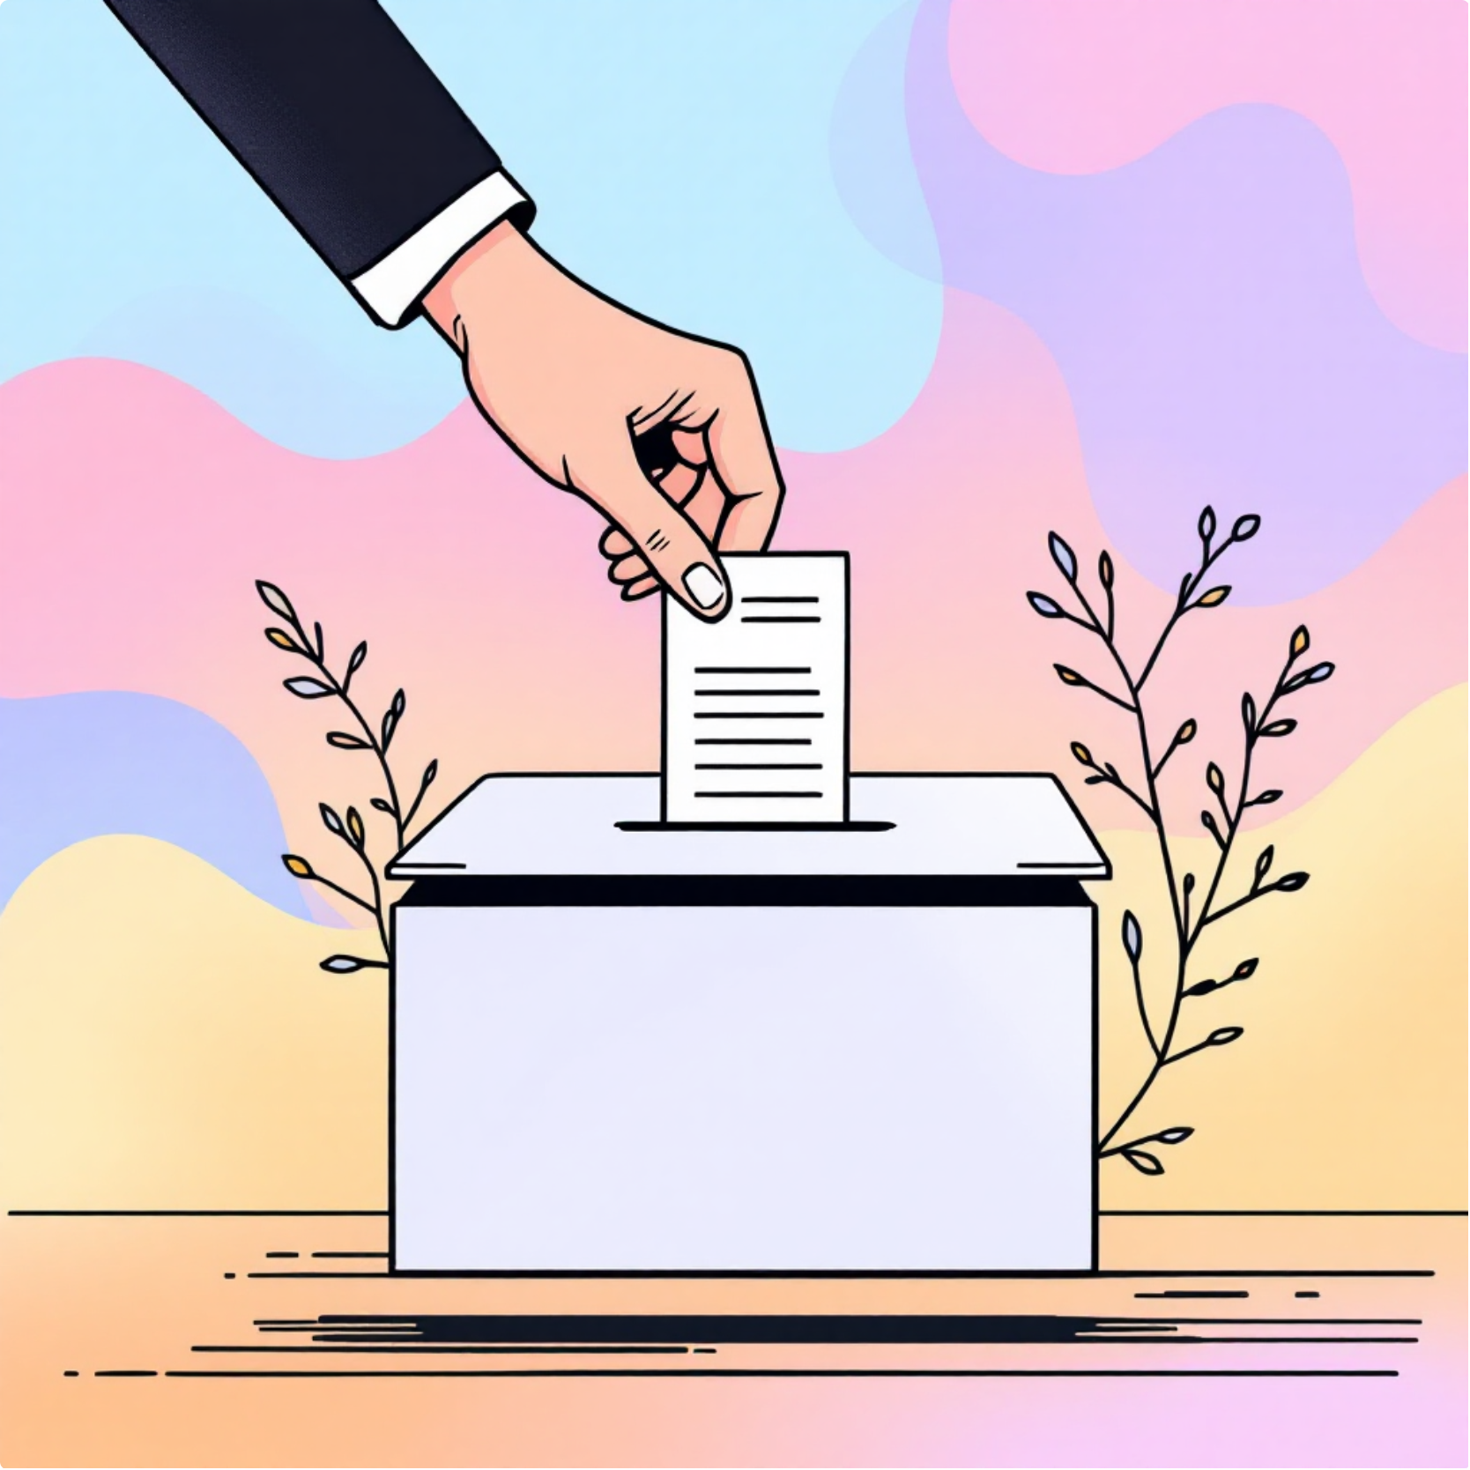

What Do Political Parties Do?
The functions of political parties extend far beyond election campaigns; they are integral to the daily functioning of governance and civic life in India.
Form Governments: Their most visible role is forming governments at national and state levels after winning elections, translating popular mandates into executive power. This involves selecting leaders and formulating administrative structures.
Shape Public Policy: Parties are instrumental in shaping public policy and legislation, reflecting their core ideologies and the mandates received from voters. They debate, propose, and enact laws that govern the nation.
Mobilise Participation: They actively mobilise popular participation and enhance political awareness among citizens through rallies, campaigns, and grassroots outreach programmes. This ensures broader engagement in the democratic process.
Bridge the Gap: Crucially, parties act as a vital bridge between the government and the people. They serve as conduits for public grievances and ensure accountability of the ruling dispensation to the electorate.

Slide 4
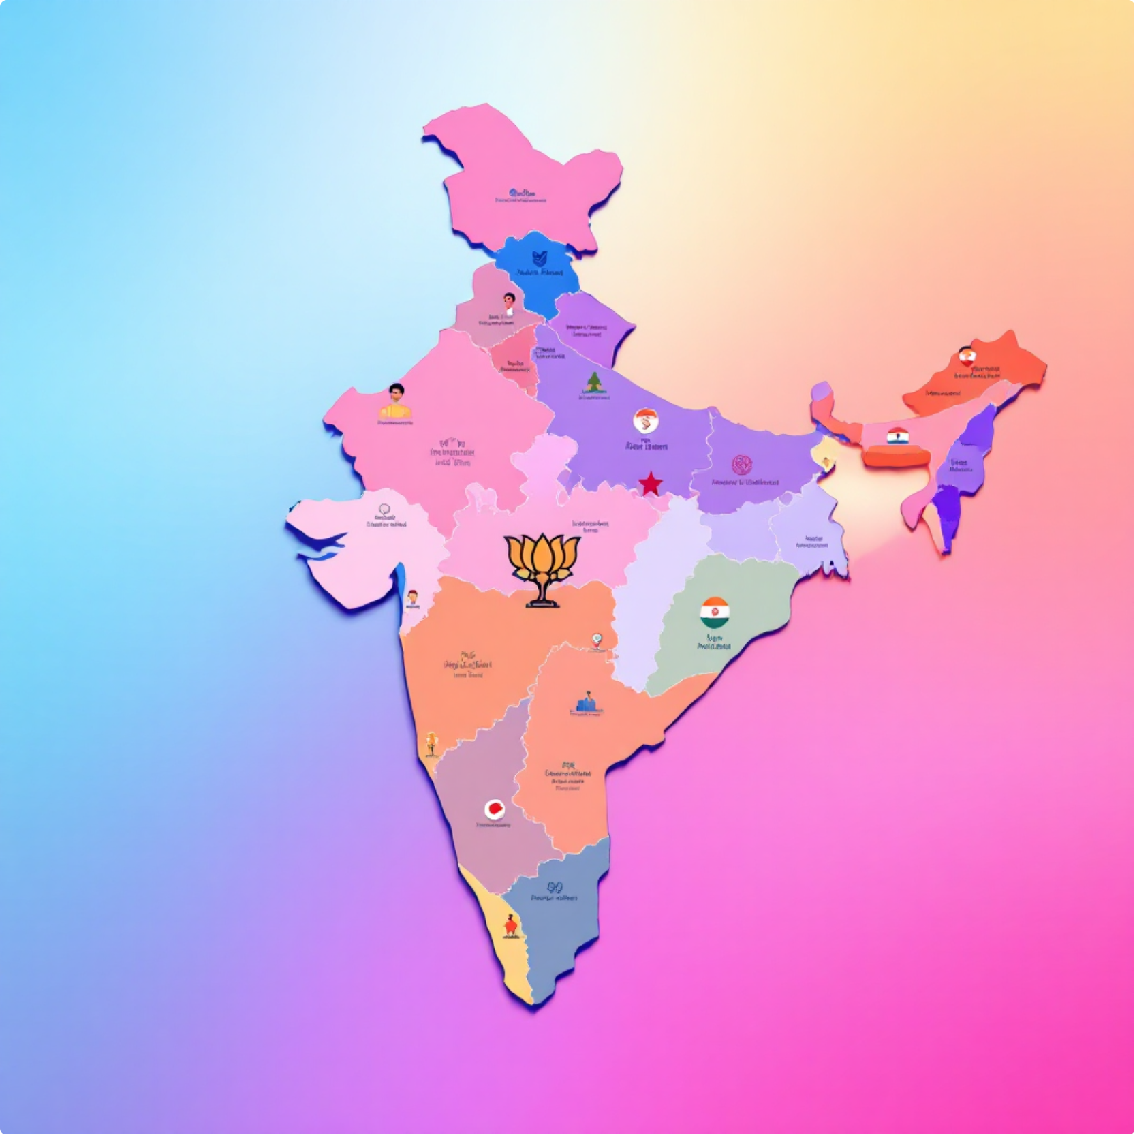
The Necessity and Number of Parties in India
India's unparalleled diversity, encompassing numerous cultures, languages, and regional identities, inherently necessitates a multi-party system. This system allows for the articulation and representation of varied interests.
India's vast diversity necessitates a multi-party system to adequately represent regional, caste, linguistic, and ideological interests that are unique to its geography and demographics.
Currently, India officially recognises 6 National Parties, which have a presence across multiple states and contest elections nationwide.
There are also 58 registered State Parties, primarily focusing on regional issues and having significant influence within specific states.
Additionally, India has over 2700 Registered Unrecognised Parties, indicating a high level of political freedom and the emergence of various local political movements.
This multiplicity fosters a vibrant, competitive democracy but can sometimes lead to coalition politics and governmental fragmentation, requiring intricate power-sharing arrangements.

Slide 5
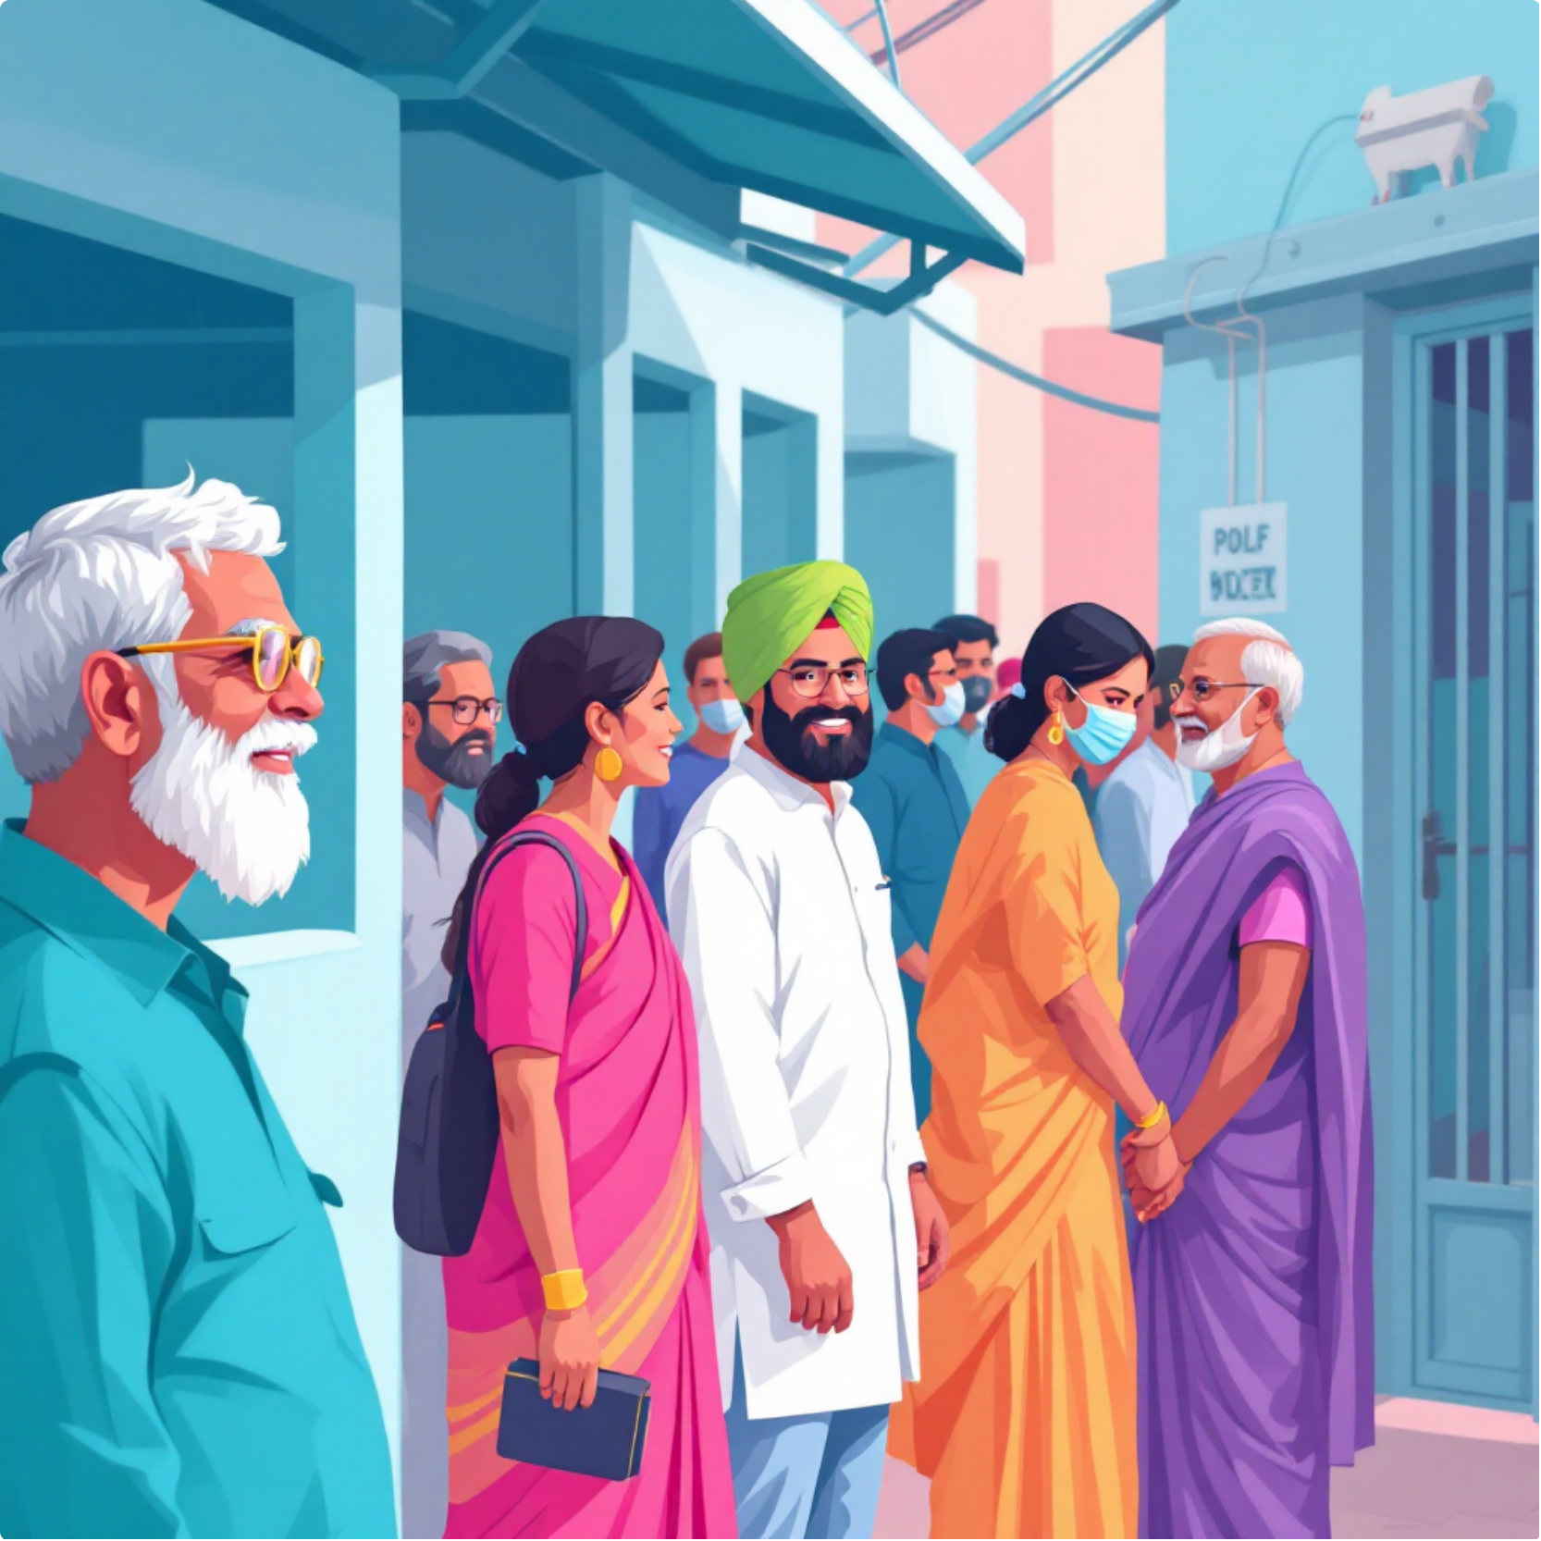
Popular Participation in Political Parties
Popular engagement with the political process in India is robust, especially evident in the consistently high voter turnout figures.
Voter turnout in India is remarkably high, particularly in rural areas, reflecting a strong and active popular engagement with the democratic process. Citizens view elections as a critical opportunity to voice their concerns and choose their representatives.
Political parties play a significant role in encouraging this participation. They do so through extensive membership drives, large-scale public rallies, and dedicated grassroots outreach programmes, connecting directly with communities.
However, a persistent challenge remains the weakness in internal party democracy. This often limits genuine participation and upward mobility within the parties themselves, leading to concerns about leadership selection and decision-making processes.
Strengthening internal democracy is crucial for parties to truly reflect the aspirations of their members and the wider electorate, enhancing their legitimacy and effectiveness.

Slide 6

National vs. State Parties: Roles and Influence
India's political landscape is defined by the interplay between national and state-level parties, each wielding distinct influence and focusing on different spheres of governance.
National Parties
State Parties
Growing Significance
Major national parties like the Bharatiya Janata Party (BJP) and the Indian National Congress boast a pan-India presence. They contest elections across most states and significantly influence policy at the central level, shaping national discourse on economy, foreign policy, and security.
Their platforms generally address broad national concerns, aiming for uniform application of policies across the country.
State parties, such as the Dravida Munnetra Kazhagam (DMK) in Tamil Nadu or the Aam Aadmi Party (AAP) in Delhi and Punjab, primarily focus on regional issues. They often champion local identities, cultural nuances, and specific interests pertinent to their states.
These parties play a crucial role in bringing regional aspirations to the national stage and advocating for decentralisation of power.
Regional parties have steadily grown in importance, often becoming indispensable in forming coalition governments at the Centre. Their significant presence in state assemblies means they drive policy innovation and implementation at the grassroots level, reflecting local priorities more closely.
This dynamic interaction ensures a nuanced and diverse policy-making environment across India.

Slide 7

Challenges Facing Political Parties in India
Despite their foundational role, political parties in India grapple with several significant challenges that impede their effectiveness and democratic health.
Electoral Funding Opacity
Factionalism & Defections
The controversial Electoral Bonds scheme, though recently struck down, highlighted deep concerns about transparency in political funding. Anonymous donations have historically created avenues for undue influence from corporations and wealthy individuals, compromising accountability.
Internal factionalism and frequent defections of elected representatives between parties weaken party discipline and undermine governance stability. This often leads to political instability and horse-trading, eroding public trust.
Populism & Short-Termism
Decline in Internal Democracy
A prevalent tendency towards populism and short-term electoral gains often overshadows the necessity for comprehensive, long-term policy planning. This can result in policies that offer immediate gratification but lack sustainable impact.
There has been a noticeable decline in internal democracy and accountability within many parties. This manifests as a lack of regular organisational elections, concentration of power in a few hands, and dynastic succession, stifling fresh leadership and genuine dissent.

Slide 8
How Can Political Parties Be Reformed?
For India's democracy to thrive, comprehensive reforms within political parties are essential. These measures aim to enhance transparency, accountability, and internal democracy.
01
02
03
Mandatory Internal Elections
Funding Transparency
Empower Election Commission
Legislation should enforce mandatory, regular, and transparent internal elections for all party positions, strengthening inner-party democracy and ensuring that leadership is chosen through democratic means, not just nomination.
Abolishing all forms of anonymous donations and mandating complete transparency in political funding is crucial. All contributions should be publicly declared, fostering greater accountability and reducing corporate influence.
The Election Commission of India (ECI) must be empowered with greater authority to impartially adjudicate defection and factional disputes, ensuring swift and fair resolutions that uphold democratic principles.
04
05
Annual Disclosures
Penalties for Non-Compliance
Parties should be legally required to provide annual public disclosures of their activities, finances, and organisational structures. This promotes accountability and allows for greater public scrutiny.
Establish clear penalties, including potential deregistration or withdrawal of recognition, for parties that consistently fail to comply with democratic norms and regulatory requirements, ensuring adherence to the rule of law.

Slide 9
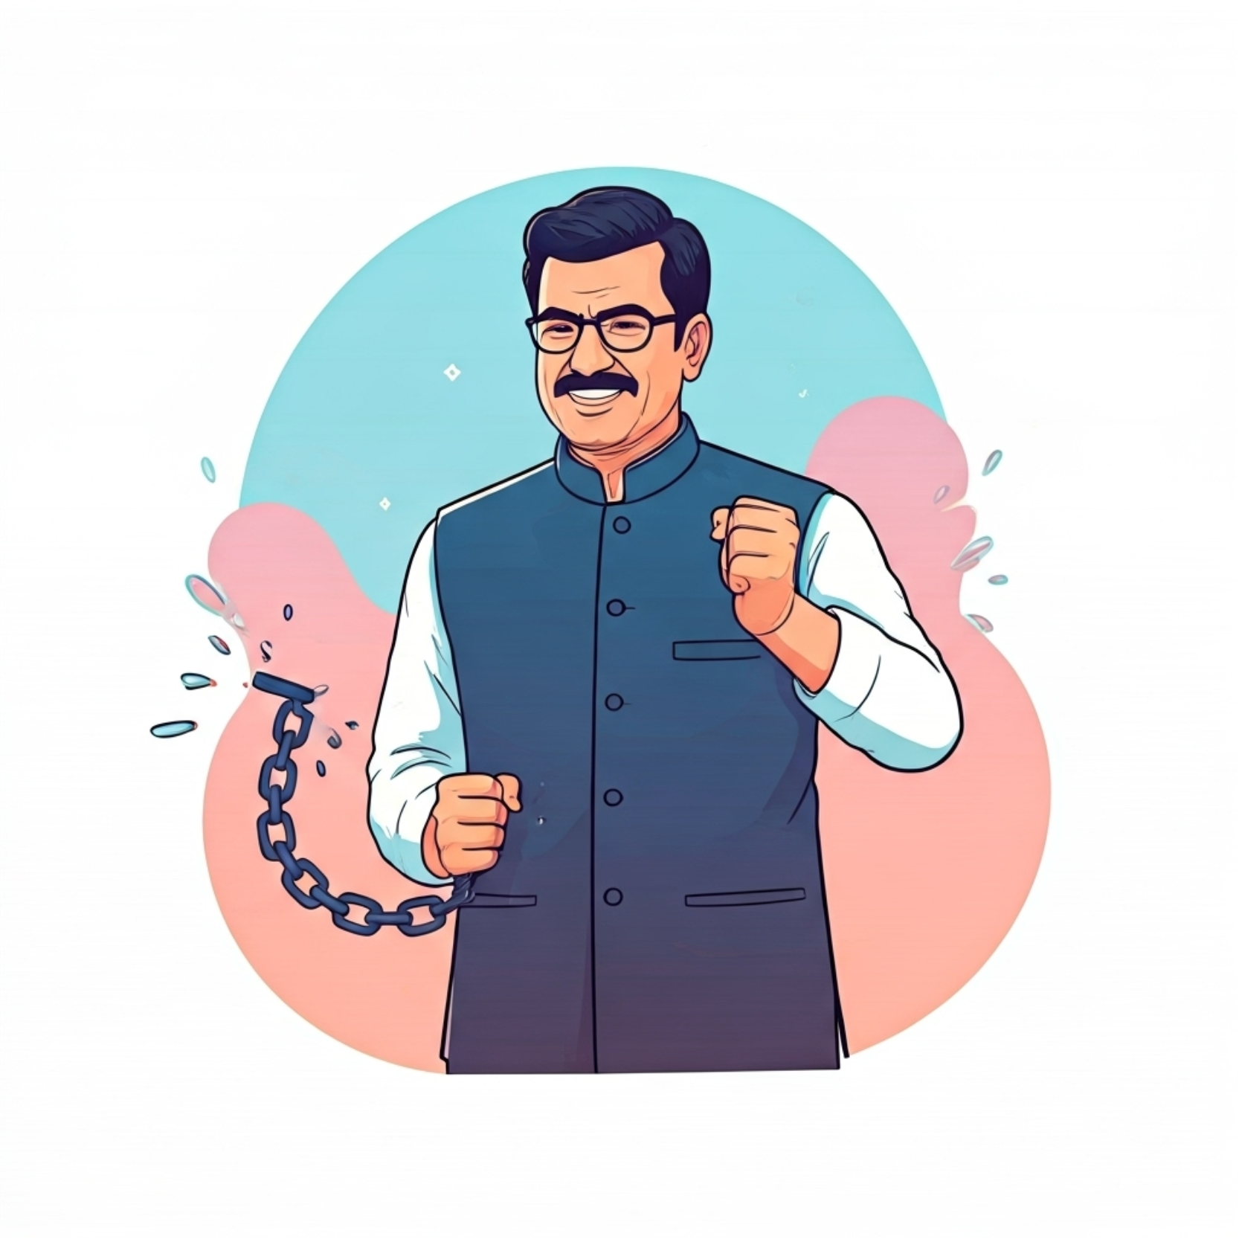
Case Study: Anti-Defection Law and Party Discipline
The Anti-Defection Law (Tenth Schedule of the Constitution) was enacted to prevent political defections. However, recent events highlight its limitations.
Recent instances of political defections in states like Maharashtra and Bihar have conspicuously exposed inherent loopholes within India’s anti-defection law. These episodes have frequently led to governmental instability and questions about the integrity of elected representatives.
There are growing calls for significant reform, including the need for clearer definitions of what constitutes a 'split' or 'merger' within a political party. Currently, ambiguities in the law are often exploited to circumvent its intent.
Furthermore, there is a strong demand for faster judicial review of defection cases, as prolonged legal battles can leave state assemblies in limbo and undermine public faith in the system. The Speaker's role also requires clearer guidelines.
Strengthening this crucial law can significantly reduce opportunistic defections, which are often driven by personal gain rather than ideological differences. This, in turn, will enhance political stability and allow governments to focus on governance rather than survival.

Slide 10
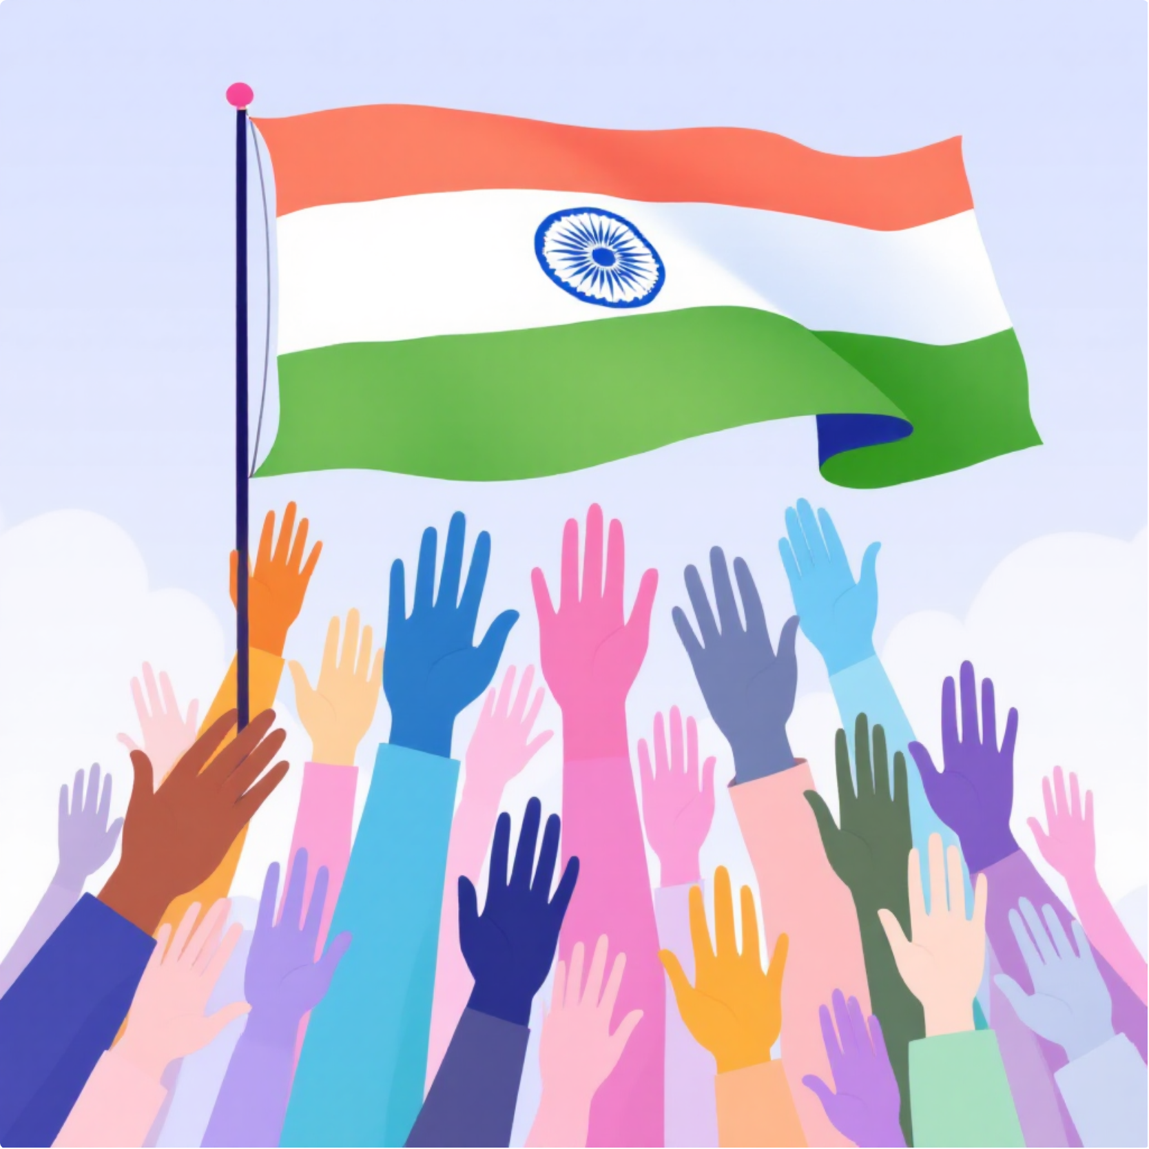
Conclusion
Strengthening Democracy Through Better Political Parties
Political parties, despite their flaws, remain the indispensable backbone of India’s democratic fabric. They are the primary instruments through which the nation's immense diversity and aspirations find voice and representation.
Addressing the prevalent challenges through targeted and robust reforms is not merely desirable but absolutely crucial. These reforms, focusing on enhancing transparency, encouraging genuine popular participation, and improving governance quality, will fortify the democratic institutions.
A vibrant, accountable, and internally democratic party system is the fundamental key to sustaining India’s democratic future and ensuring inclusive development for all its citizens. It guarantees that the voice of the people remains supreme and effective in shaping the nation's destiny.

